Slide 1
Le Japon vit-il ses derniers jours? Is Japan’s end near? Tokyo, juin 2016
Robert Dujarric (Temple University Japan)
Sarah O’Connell (Bryn Mawr College)
Eimi Satoh (Brown University)
robertdujarric@gmail.com
www.tuj.ac.jp/icas

Slide 2
Japan 2015

Slide 3
USA 2015

Slide 4
France 2015
Notes:
Census Bureau US International database

Slide 5
Germany 2015

Slide 6
Total Fertility Rate

Slide 7
Births Per Year (1000s)
 | 1990-95 | 1995-2000 | 2000-2005 | 2005-2010 | 2010-2015
Japan | 6101 | 5916 | 5645 | 5525 | 5261
Germany | 3960 | 3907 | 3554 | 3339 | 3357
Italy | 2755 | 2641 | 2716 | 2797 | 2566
France | 3646 | 3646 | 3646 | 3646 | 3646
Notes:
http://esa.un.org/unpd/wpp/Download/SpecialAggregates/Ecological/
http://esa.un.org/unpd/wpp/DVD/Files/3_Indicators%20(Special%20Aggregates)/EXCEL_FILES/4_Ecological/Fertility/WPP2015_SA4_FERT_F01_BIRTHS_BOTH_SEXES.XLSX (xl data)

Slide 8
Migratory flows

Slide 9
Number of Foreigners
 | Foreign-National |  | Foreign-born |  | Total
 | Number | % of Total Population | Number | % of Total Population | Number
Japan | 2, 121, 831 | 1.68% | N/A | N/A | 126,343,333
Germany | 7,539,774 | 9.3% | 10,220,418 | 12.6% | 81,197,537
France | 4,355,707 | 6.6% | 7,908,661 | 11.9% | 66,415,161
UK | 5,422,094 | 8.4% | 8,411,021 | 13.0% | 64,875,165
Notes:
Sources: Eurostat, House of Commons, http://researchbriefings.parliament.uk/ResearchBriefing/Summary/SN06077
http://www.stat.go.jp/english/data/nenkan/1431-02.htm, http://www.stat.go.jp/data/nenkan/zuhyou/y650214000.xls, http://www.dw.com/en/germanys-foreign-population-cleared-8-million-in-2014/a-18318656 (highest number of foreigners in Germany)

Slide 10
Population née à l’étranger: Japon: 1,7% (2,1m)
Notes:
Pew Research 2014
http://www.moj.go.jp/housei/toukei/toukei_ichiran_touroku.html for Japan
From AT

Slide 11
London vs. Tokyo: % of foreign residents
Greater London (Inner and Outer London)
Greater Tokyo (Chiba, Saitama and Kanagawa and the 23 wards)
Ethnicity and Country of Birth | Total (2011) | Population % (2011)
Foreign Residents (Country unspecific) | 2,998,264 | 37%
People’s Republic of China (PRC)/British Chinese | 124,250 | 1.52%
India/ British Indian | 542,857 | 6.64%
Germany | 55,476 | 0.40%
Russia | 26,603 | 0.30%
United States of America | 63,920 | 0.42%
Ethnicity and Country of Birth | Total (2012) | % of Population
Foreign Residents (Country unspecific) | 322,525 | 2.4%
People’s Republic of China (PRC) | 167,559 | 1%
India | (*) | (*)
Germany | (*) | (*)
Russia | (*) | (*)
United States of America | 17,281 | >0.5%
London Figures
Source: Greater London Authority, 2011 Diversity Census https://files.datapress.com/london/dataset/2011-census-diversity/2011-census-diversity-in-london.pdf &
Carlos Vargas-Silva (Oxford) http://www.migrationobservatory.ox.ac.uk/sites/files/migobs/Briefing%20-%20London%20census%20profile_0.pdf
Source: Statistics Japan, 2012. http://stats-japan.com/t/tdfk/tokyo
Notes:
http://unctad.org/en/Pages/DIAE/World%20Investment%20Report/Country-Fact-Sheets.aspx 1 Jan 2016 http://www.e-stat.go.jp/SG1/estat/List.do?lid=000001139146

Slide 12
Féminisation
% de femmes:
Postes de direction: Japon 7%, France 26%, USA 20%, Allemagne 31%.
Conseils d’administration: Japon 1,1%, Norvège 40%, France 18%, Allemagne 14%, USA 17%.
Université de Tokyo (gakubu) 18%, Polytechnique 14%, West Point 17%, MIT 46%.
Notes:
http://www.catalyst.org/knowledge/women-management-global-comparison 2 Jan 2016 http://www.catalyst.org/knowledge/women-academia http://www.catalyst.org/knowledge/board-seats-held-women-country http://www.u-tokyo.ac.jp/en/about/enrollment.html http://www.usma.edu/admissions/sitepages/class%20profiles.aspx http://www.ingenieurs.com/comment-devenir-ingenieur/les-filles-dans-les-ecoles-d-ingenieurs-1469.php

Slide 13
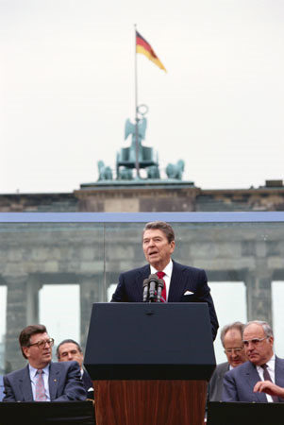
Notes:
http://www.crfmedia.com/Video-Belarus/09%20Title.jpg (28 Feb. 2010)

Slide 14
Japan’s elite bred behind a Wall
Except for Chinese and Koreans few foreign students and professors. Academic research cut off from outside world.
Elite education: Foreign students: Tokyo University Law Faculty 1%, Harvard University 19%.
Overseas high school/college education relatively rare (no Erasmus, difficult to get credit for study abroad, school year different from the West).
Ambivalent attitude towards foreign study/experience.
14
Notes:
Harvard Fact book http://www.provost.harvard.edu/institutional_research/2007OnlineFactbook.pdf page 16
http://opendoors.iienetwork.org/?p=113743 2006/07 year
http://www.census.gov/cgi-bin/ipc/idbagg
http://www.microsoft.com/presspass/exec/default.mspx?group=a-d

Slide 15
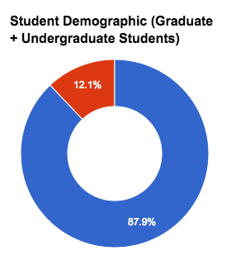
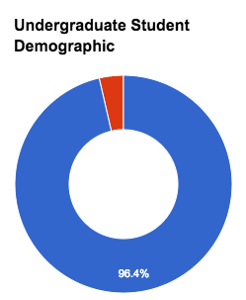
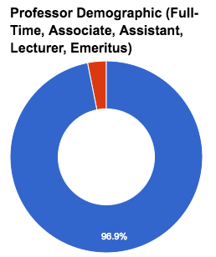
Foreign Students and Professors in Japanese Higher Education Institutions: University of Tokyo
(as of May 2015)
Top 5 Represented Countries within the Student Population
Totals
Country of Origin | Number of Students
China | 1268
South Korea | 486
Taiwan | 149
Thailand | 113
India | 68
 | Students | Undergraduate Students | Professors
Domestic | 24750 | 13627 | 2347
Foreign | 3394 | 509 | 76
Total | 28144 | 14136 | 2423
Notes:
Sources: http://www.u-tokyo.ac.jp/content/400041474.pdf

Slide 16
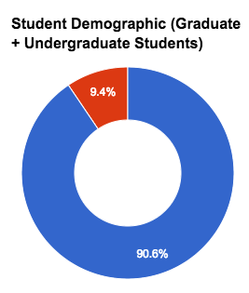
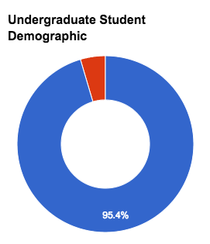
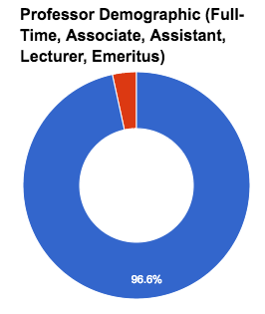
Foreign Students and Professors in Japanese Higher Education Institutions: Waseda University
(as of May 2015)
Top 5 Represented Countries within the Student Population
Totals
Country of Origin | Number of Students
China | 2467
South Korea | 897
Taiwan | 381
United States | 179
Thailand | 103
 | Students | Undergraduate Students | Professors
Domestic | 47161 | 41455 | 1584
Foreign | 4917 | 1985 | 56
Total | 52078 | 43440 | 1640
Notes:
Sources: https://www.waseda.jp/inst/cie/assets/uploads/2015/10/20150501_jp.pdf, http://www.waseda.jp/top/assets/uploads/2015/08/students2015.pdf

Slide 17
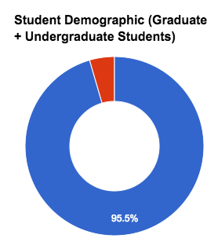
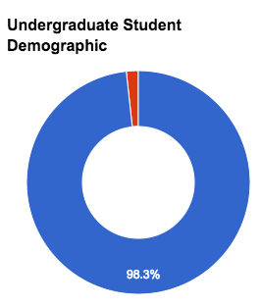
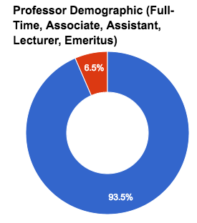
Foreign Students and Professors in Japanese Higher Education Institutions: Keio University
(as of May 2016)
Top 5 Represented Countries within the Student Population
Totals
Country of Origin | Number of Students
China | 549
South Korea | 262
Taiwan | 98
France | 84
United States | 65
 | Students | Undergraduate Students | Professors
Domestic | 32107 | 28239 | 1455
Foreign | 1518 | 496 | 101
Total | 33625 | 28735 | 1556
Notes:
Sources: http://www.ic.keio.ac.jp/data/, http://www.keio.ac.jp/ja/about_keio/data/kr7a430000000hm3-att/2016_daigaku.pdf

Slide 18
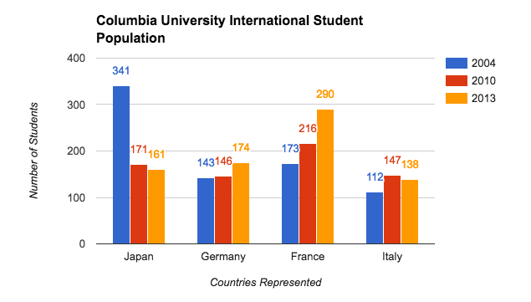
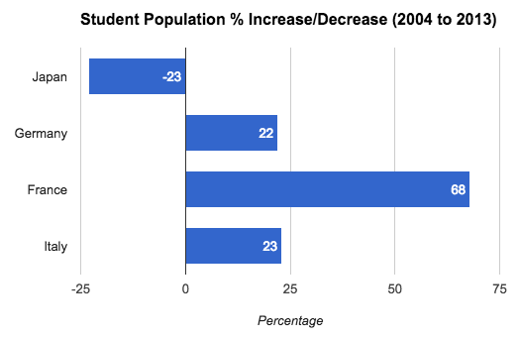
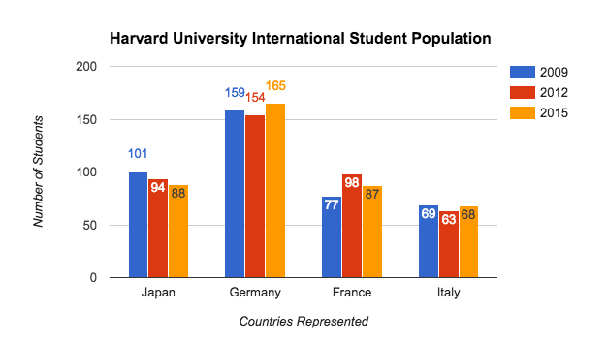
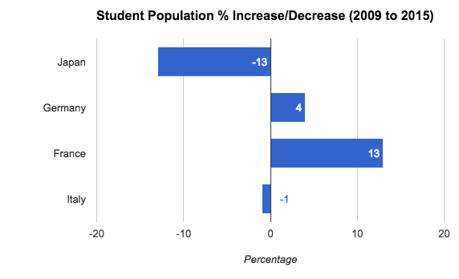
Foreign Students in U.S. Higher Education Institutions
(inclusive of undergraduate and graduate students)
Notes:
Sources: http://www.columbia.edu/cu/isso/fallreport/, http://www.hio.harvard.edu/statistics

Slide 19
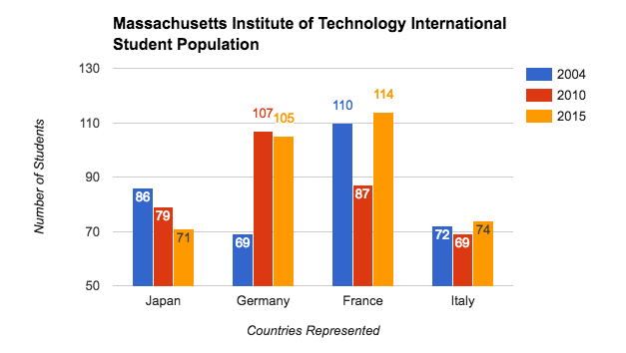
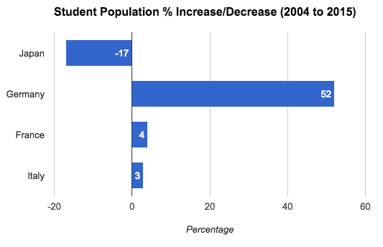
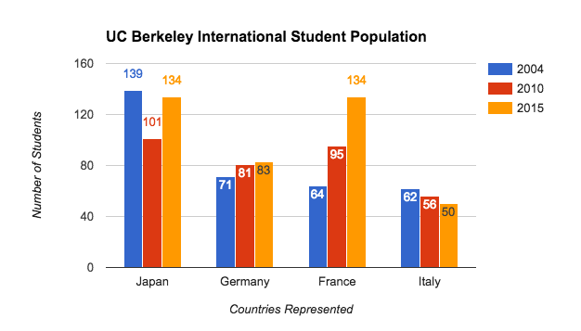
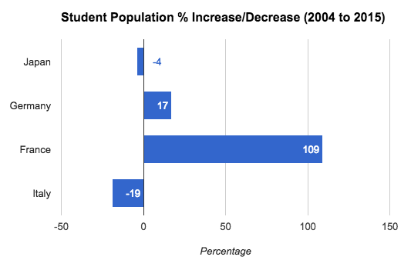
Foreign Students in U.S. Higher Education Institutions
(inclusive of undergraduate and graduate students)
Notes:
Sources: http://web.mit.edu/iso/about/statistics.shtml, http://internationaloffice.berkeley.edu/students/current/enrollment_data,

Slide 20
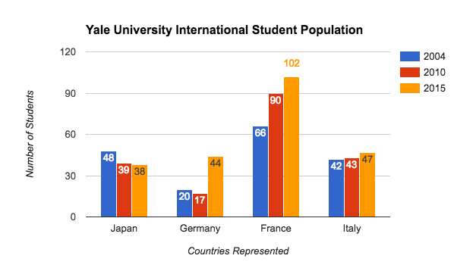
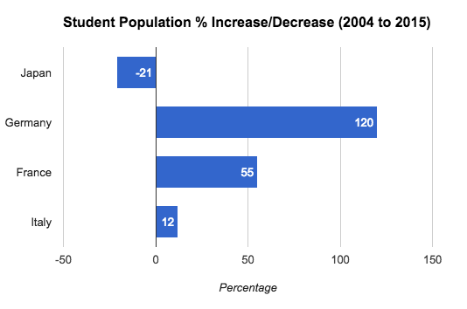
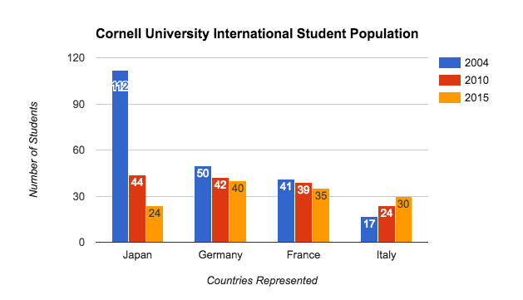
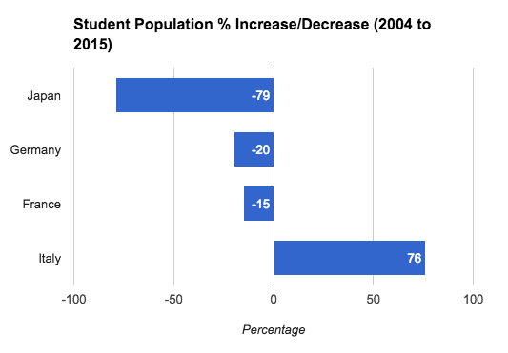
Foreign Students in U.S. Higher Education Institutions
(inclusive of undergraduate and graduate students)
Notes:
Sources: http://oiss.yale.edu/about/statistics/2015-2016, http://isso.cornell.edu/about/data-resources/statistics

Slide 21
Few Japanese Teaching at Foreign Universities
(numbers as of 2016)
 | Total Faculty Members (Active/Full-Time, Courtesy/Part-Time, Visiting, Emeritus, Affiliated, Lecturer Positions) | Number of Japanese Faculty Members | Faculty Member Names
Stanford - Electrical Engineering | 156 | 5 | Dwight Nishimura*, Yoshio Nishi, Yoshihisa Yamamoto, Daisuke Kanemoto, Osamu Nakatsuka
Chicago - Economics | 53 | 1 | Kotaro Yoshida*
Johns Hopkins - SAIS | 331 | 2 | David Arase, Kuniko Ashizawa
Columbia – Math, Physics and Computer Science | 182 | 2 | Masatake Kuranishi, Yasutomo Uemura
Harvard - Harvard Business School | 264 | 2 | Vicki Sato*, Hirotaka Takeuchi
MIT - Physics | 120 | 0 | --
LSE - Economics | 86 | 2 | Taisuke Otsu, Nobuhiro Kiyotaki
Oxford – Economics | 72 | 0 | --
Cambridge - Economics | 58 | 0 | --
*Faculty member may not be of Japanese nationality or have Japanese higher education affiliation.
Notes:
Sources
Stanford: https://ee.stanford.edu/people/faculty
UChicago: https://economics.uchicago.edu/facstaff/
Johns Hopkins: https://www.sais-jhu.edu/faculty-directory?field_profile_faculty_status_tid&field_profile_campus_tid=All
Columbia: http://www.cs.columbia.edu/people/faculty, http://www.math.columbia.edu/people/faculty-by-rank/, http://physics.columbia.edu/people/faculty
Harvard: http://www.hbs.edu/faculty/Pages/browse.aspx
MIT: http://web.mit.edu/physics/people/faculty/index.html
LSE: http://www.lse.ac.uk/economics/people/facultyA-Z.aspx
Oxford: http://www.economics.ox.ac.uk/people/faculty
Cambridge: http://www.econ.cam.ac.uk/people/index.html?group=faculty&time=present

Slide 22
International organizations: Japanese underrepresented
International Monetary Fund Economists (2013)
- Japan 40/9 (Professional Staff/Managerial Staff)
- India 32/15
- Australia 19/7
United Nations Professional staff
Japan 291/790 (regular/total)
France 848/1932
Germany 476/1222
Italy 561/1427
Notes:
http://www.unsceb.org/CEBPublicFiles/CEB_2014_HLCM_HR_21.pdf (as of December 2013)

Slide 23
Little foreign business presence
Low foreign investment level (FDI): 4.1% of gdp vs. average for developed countries of 24.7% and 16.0% for the US.
Few opportunities to work for foreign corporations in Japan.
Few expatriates.
Notes:
Kent E. Calder, Pacific Alliance (New Haven: Yale University Press, 2009).
UNCTAD, http://www.unctad.org/sections/dite_dir/docs/wir09_fs_jp_en.pdf (accessed 29 September 2009)

Slide 24
GDP (US$, current exchange rates)
Notes:
Wold Bank data

Slide 25
GDP (with PPP per capita)

Slide 26
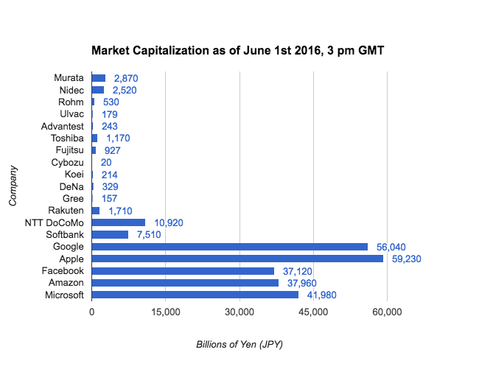
Market Capitalization

Slide 27
Will it change?
Japan is a very pleasant place to live and work, little incentive to get out.
High linguistic/cultural barriers to entry for foreigners.
Japan is fully modern; but “leave Asia Join the West” 脫亞入歐 still resonates in other nations. (Or now “Leave home, join the world,” 脫巢入世). Different from even the 1950s.
Japan large/rich enough to set its own standards at little cost (language, school year, foreign investment, etc.).
Weak institutions – strong men (early Meiji) replaced by strong institutions – weak men (today).
The “system” serves the (subconscious) goals of the establishment.
Notes:
Lenovo acquisition (Nikkei Business 2 June 2008)

Slide 28
Traditions
Self-orientalizing
We are the makers of manners (Henry V, V, 2)
Désobéir un peu n’est pas un si grand crime (Le Cid, II, 1).
La valeur n’attend point le nombre des années (Le Cid, II, 2).

